Slide 1
Customer Retention Case Study Presentation
PREPARED BY AKASH KUMAR

Slide 2

Agenda
Introduction
Problem Statement
Objective
Exploratory Data Analysis (EDA)
Visualization
Inference
Future Work

Slide 3
Introduction
What is Customer Retention and do we really need it?
"The capacity of a corporation to turn consumers into repeat buyers and keep them from moving to a rival is referred to as customer retention."
To put it another way, client retention entails "maintaining current consumers.”
This happens only if there exists a positive relation between the company and the customer.

Slide 4
What are the advantages of keeping customers?
Customers who have been with the firm for a long time are more likely to purchase additional services from them.
Customers that have been with you for a long time are believed to be less price/cost sensitive.
A60-70 percent chance of selling to an existing customer exists.
The likelihood of selling to a fresh prospect is 5-20%.
Migration rates have slowed.
Getting a new client is more expensive than keeping an existing one.

Slide 5
Customer Retention Strategies to Help You Succeed
Find out what your consumers desire and why they remain or go.
Collect and promote client feedback in a proactive manner.
Analyze client feedback to acquire useful insights and make sure it reaches the proper people.
Make a move and Analyze the outcomes
Measure and track your consumers' loyalty and involvement on a regular basis.
Continue to inquire, listen, analyse, and improve.

Slide 6
Motivation for the Problem Undertaken
Consumer retention entails more than simply providing what the customer expects.
Exceeding client expectations may be necessary to create brand loyalists.
Customer loyalty is achieved by putting "customer value, rather than maximisation of profits and shareholder value, at the core of corporate strategy."
In a competitive climate, delivering a consistently high level of customer service is frequently the crucial differentiator.
Furthermore, retention is a crucial goal in the new world of Customer Success.

Slide 7
Problem Statement
Customer satisfaction has emerged as one of the most important factors that guarantee the success of online store; it has been posited as a key stimulant of purchase or repurchase intentions and customer loyalty.
A comprehensive review of the literature, theories and models have been carried out to propose the models for customer activation and customer retention.
Five major factors that contributed to the success of an e-commerce store have been identified as: service quality, system quality, information quality, trust and net benefit.
The research furthermore investigated the factors that influence the online customers repeat purchase intention.
The combination of both utilitarian value and hedonistic values are needed to affect the repeat purchase intention (loyalty) positively.
The data is collected from the Indian online shoppers. Results indicate the e-retail success factors, which are very much critical for customer satisfaction.

Slide 8
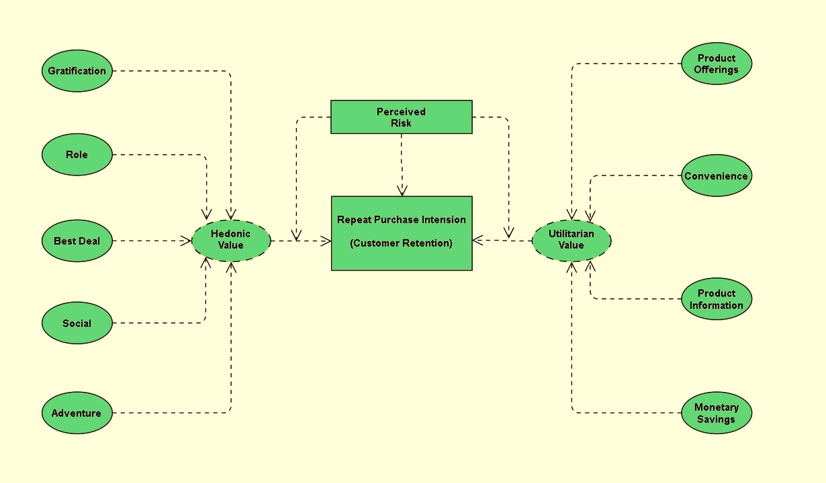
The problem statement can be represented in the form of below use case diagram as well.

Slide 9
Objective
The goal is to employ analytical abilities to come up with discoveries and conclusions that will enable an E-Retail firm forecast client retention utilizing data on customers collected over time.
I was given the responsibility of finding which elements were most significant in the loss of a valuable client using the model, and then devising a strategy for how the organization might use this knowledge to boost customer retention.

Slide 10
Exploratory Data Analysis (EDA)
Requirements | Tools Used
Hardware: | CPU : ideapad 3 CHIP: Ryzen 5 Hexa Core RAM: 8GB GPU : 8GB
Software: | Programming language : Python Distribution : Anaconda Navigator Browser based language shell : Jupyter Notebook
Libraries/Packages: | Pandas NumPy matplotlib seaborn scikit-learn

Slide 11
First, I loaded the complete dataset into our Jupyter Notebook and renamed the columns after importing the appropriate libraries. Then I looked at the layout of our data and saw that we had 269 rows and 71 distinct columns. In our dataset, there are no null or missing values. In our dataset, there are 22% duplicate records; nevertheless, rather than eliminating them, I elected to keep them. By looking at the data types, I discovered that all of the columns are of the 'object' data type, with the exception of the Pin Code column, which is of the 'integer' data type.
Shape : 269 rows and 71 columns.
No null values present.
22% duplicate fields/records found.
Datatypes of all the columns are objects except for the “Pin Code" column which has integers.

Slide 12





Data Description
The information was gathered from Indian internet shoppers. Our data collection includes consumer reviews and comments from Amazon, Flipkart, Snapdeal, Myntra, and Paytm, five of India's most popular online retailers.
With the purpose to suggest, a questionnaire is created based on brand strength, brand empathy or dedication, total consumer happiness, and perceived value for money.
The findings reveal the essential e-retail success elements for customer happiness and retention.
The top 5 Indian Online Retailers:

Slide 13
Visualization
What is the definition of data visualization? A graphical depiction of information and data is referred to as data visualization.
What are the advantages of good data visualization? Data visualization is another visual art approach that piques our interest and retains our attention on the message collected by the eyes.
There are several types of data visualization analysis:
1. Univariate Analysis: We will use a single characteristic to assess practically all of its attributes in a univariate analysis.
2. Bivariate Analysis: Bivariate analysis is when we compare data between two attributes that are precisely the same.
3. Multivariate Analysis: We shall compare more than two variables in the multivariate analysis.

Slide 14
Univariate Analysis:
I was able to determine the total number of rows covered by each unique category value contained in all columns of our dataset using count plots. I made sure that the proportion of data coverage is presented with the overall row number.

Slide 15
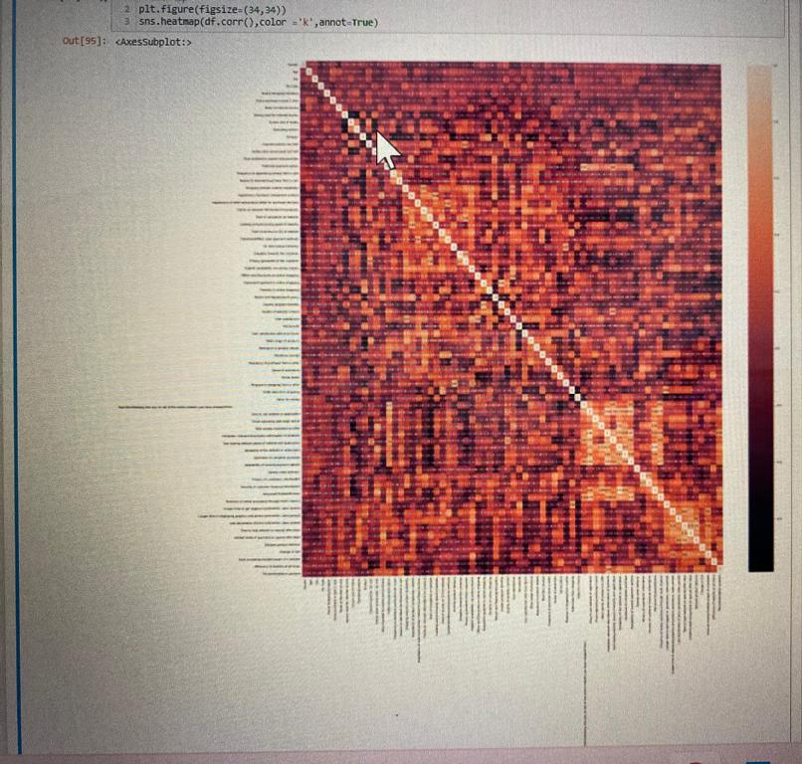
Multivariate Analysis:
To observe the correlation information between the columns, I utilized the heatmap on the encoded dataset. Even though the picture was too small to see on the Jupyter Notebook, I was able to deduce from the color choices that there is no multi collinearity between the columns.

Slide 16
Inference
The first 47 aspects, based on general observations, give insights into how e-retail is beneficial and increasing based on consumer feedback. The data revealed which CITY, PIN CODE, AGE, and other variables were utilized most frequently on the web platform. It also revealed that some criteria are given less weight in contributing to the success of an e-commerce site, allowing us to eliminate such aspects while keeping all the vital ones. We might also improve on some of the elements that impact the likelihood of repeat purchases by internet clients.
Apart from the first 47 elements, the remaining features demonstrated which web platform was utilized more frequently depending on success factors. According to the customer activation and retention case study, Amazon is the most dependable and has met all of the consumer needs. Following Amazon, research indicated that Flipkart was utilized more for online shopping.
According to a case study of Indian e-commerce clients, Amazon and Flipkart are the most frequently utilized for online shopping and are the most frequently suggested by friends. So, based on the research considerations, Amazon and Flipkart are e-commerce platforms that combine utilitarian and hedonistic values to favorably influence recurrent purchase intent (loyalty).

Slide 17

1. Amazon
To be improved:
During promotions, attempt to provide clients with a stress-free shopping experience.
Provide customers with extra payment alternatives.
Give the pricing as soon as possible during the offer.
Shorten the time it takes for things to arrive.
Positive feedback summary:
It's easy to use, and it's also a fantastic buying site.
Products are delivered quickly.
Availability of comprehensive product information.
Multi-channel online assistance is available.
Trustworthy website or app, as well as perceived trustworthiness.
E-Commerce Company:

Slide 18

2. Flipkart
To be improved:
During promotions, attempt to provide clients with a stress-free shopping experience.
Provide customers with extra payment alternatives.
Give the pricing as soon as possible during the offer.
Shorten the time it takes for things to arrive.
The only difference between Flipkart and Amazon is that their feedbacks
are practically identical, with varied percentages.
Positive feedback summary:
It's easy to use, and it's also a fantastic buying site.
Products are delivered quickly.
Availability of comprehensive product information.
Multi-channel online assistance is available.
Trustworthy website or app, as well as perceived trustworthiness.
A wide range of items are available.
E-Commerce Company:

Slide 19
3. Myntra
To be improved:
During promotions, attempt to provide clients with a stress-free shopping experience
During promotions, try to offer the pricing as soon as possible.
During promotions, reduce the time it takes for things to arrive.
Positive feedback summary:
It's easy to use and has an excellent webpage.
A variety of payment alternatives are available.
Products are delivered more quickly.
Detailed information on all available goods.
Trustworthy website or app, as well as perceived trustworthiness.
A wide range of products to choose from
E-Commerce Company:

Slide 20

4. Paytm
To be improved:
During promotions, reduce the time it takes for things to arrive.
Give the pricing as soon as possible during the offer.
During promotions, attempt to provide clients with a stress-free
shopping experience.
Price and discount announcements are made late.
When moving from one page to the next, there is a lot of noise.
Positive feedback summary:
It's easy to use and has an excellent webpage.
The ability to finish a transaction in a timely manner.
About 64% of consumers believe that either the web or the app is
trustworthy.
Paytm is thought to have a wide range of items, according to 20% of
consumers.
E-Commerce Company:

Slide 21
5. Snapdeal
To be improved:
During promotions, reduce the time it takes for things to arrive.
Give the pricing as soon as possible during the offer.
During promotions, attempt to provide clients with a stress-free
shopping experience.
Price and discount announcements are made late.
No one has indicated a desire to promote Snapdeal to a contact since it
has the most number of negative reviews of any other website.
Positive feedback summary:
It's simple to use.
A total of 54% of consumers are satisfied with the provision of financial data security.
E-Commerce Company:

Slide 22
Future Work
I'll have to do some preparation with the data, such as utilizing scaling algorithms.
I'm not going to bother about reducing outliers or skewness because the dataset contains largely categorical data.
Unsupervised machine learning models must be built.
Will need to double-check the specifics of the clustering or association method that may be employed on the dataset.
K-means clustering, k-nearest neighbours for unsupervised machine learning, hierarchal clustering, apriori algorithm, and neural networks are some of the methods I plan to work on.

